Slide 1
Domain: Salesforce Developer Use Case : Vehicle Management Systems
TEAM MEMBERS GUIDE : Mr.VENKATA RAMANEN
Boojika M MENTOR :Mr.VENKATA RAMANEN
Jayashree A
Rohini B
Sivaranjani P
Vishnu Mithran

Slide 2
What is Salesforce ?
Salesforce a CRM platform and it is a Saas Cloud . Apart from this, it is game-changing technology, with a host of productivity- boosting features, that will help you sell smarter and faster.
Salesforce has everything you need to run your business from anywhere. Using standard products and features, you can manage relationships with prospects and customers, collaborate and engage with employees and partners, and store your data securely in the cloud.
Salesforce is your customer success platform, designed to help you sell, service, market, analyze, and connect with your customers.
Access a vast marketplace of third-party applications and integrations to extend the functionality of Salesforce.
Empower sales teams with tools for lead management, opportunity tracking, and forecasting.

Slide 3
What is Vehicle Management System ?
A Vehicle Management System (VMS) is a comprehensive software solution designed to streamline and enhance the management of vehicles in an organization. It encompasses a range of functionalities tailored to meet the specific needs of fleet operators, enabling them to effectively oversee the entire lifecycle of their vehicles.
Key Components of a VMS:
Maintenance and Servicing:
Schedule, track, and optimize maintenance tasks to ensure vehicles remain in peak operational condition.
Sales and Customer Management:
Facilitate sales processes, manage customer interactions, and nurture client relationships.
Reporting and Analytics:
Generate insightful reports and utilize data analytics to make informed decisions about vehicle operations.

Slide 4
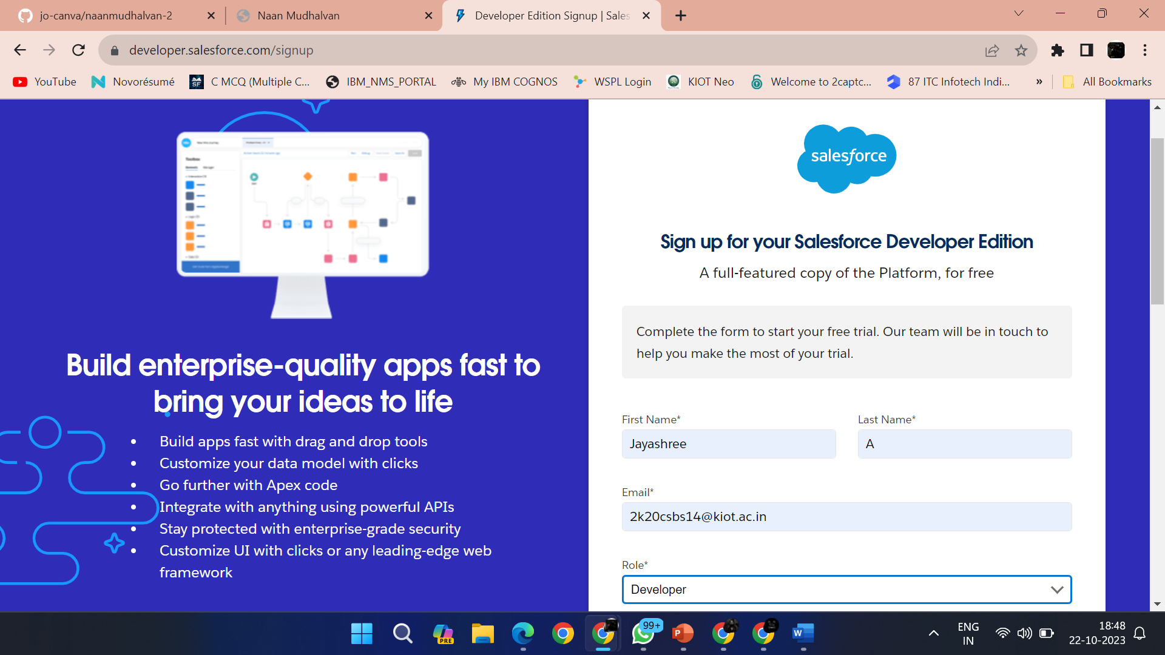
CREATION OF DEVELOPER ACCOUNT
A Developer org has all the features and licenses you need to get started with Salesforce.1.Search Developer.salesforce.com/signup

Slide 5
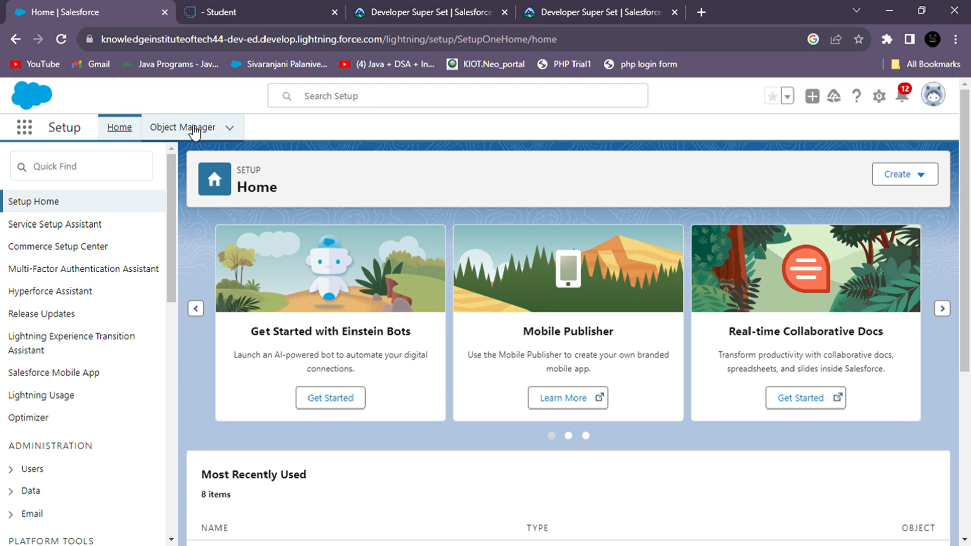
HOME PAGE

Slide 6
WHAT IS A SALESFORCE OBJECT?
Salesforce objects are database tables that permit you to store data that is specific to an organization. It consists of fields(columns) and records (rows).
SALESFORCE OBJECTS ARE OF TWO TYPES
I . Standard Objects: Standard objects are the kind of objects that are provided by salesforce.com such as users, contracts, reports, dashboards, etc.
Ii . Custom Objects: Custom objects are those objects that are created by users. They supply information that is unique and essential to their organization. They are the heart of any application and provide a structure for sharing data.

Slide 7
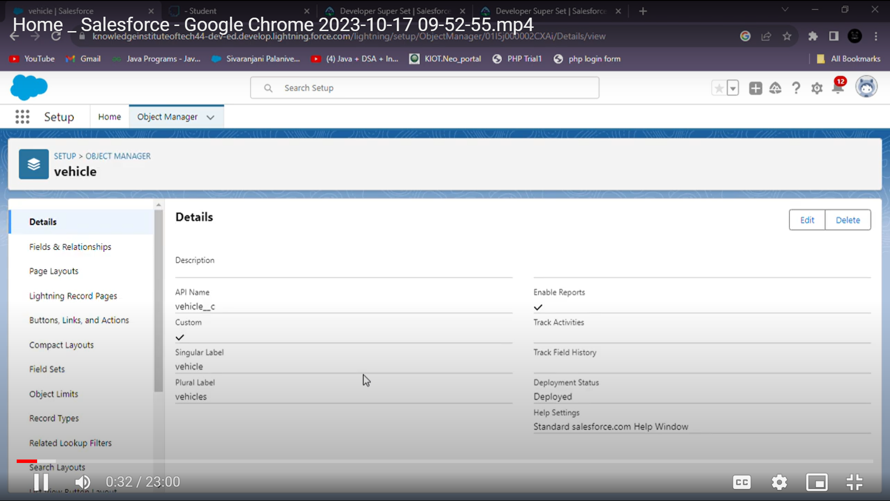

Slide 8
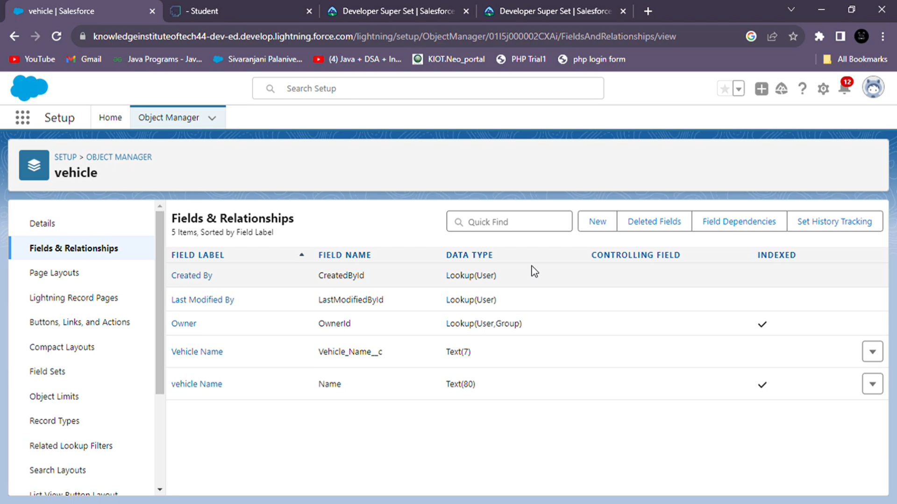

Slide 9
FIELDS AND RELATIONSHIP
What are fields?
Fields in Salesforce represent what the columns represent in relational databases. It can store data values which are required for a particular object in a record.
There are 2 types of fields in salesforce:
Standard fields:
There are four standard fields in every custom object that are Created By, Last Modified By, Owner, and the field created at the time of the creation of an object. These fields cannot be deleted or edited and they are always required. For standard objects, the fields which are present by default in them and cannot be deleted from standard objects are standard fields.
Custom fields:
The Custom fields which are added by the administrator/developer to meet the business requirements of any organization. They may or may not be required.

Slide 10
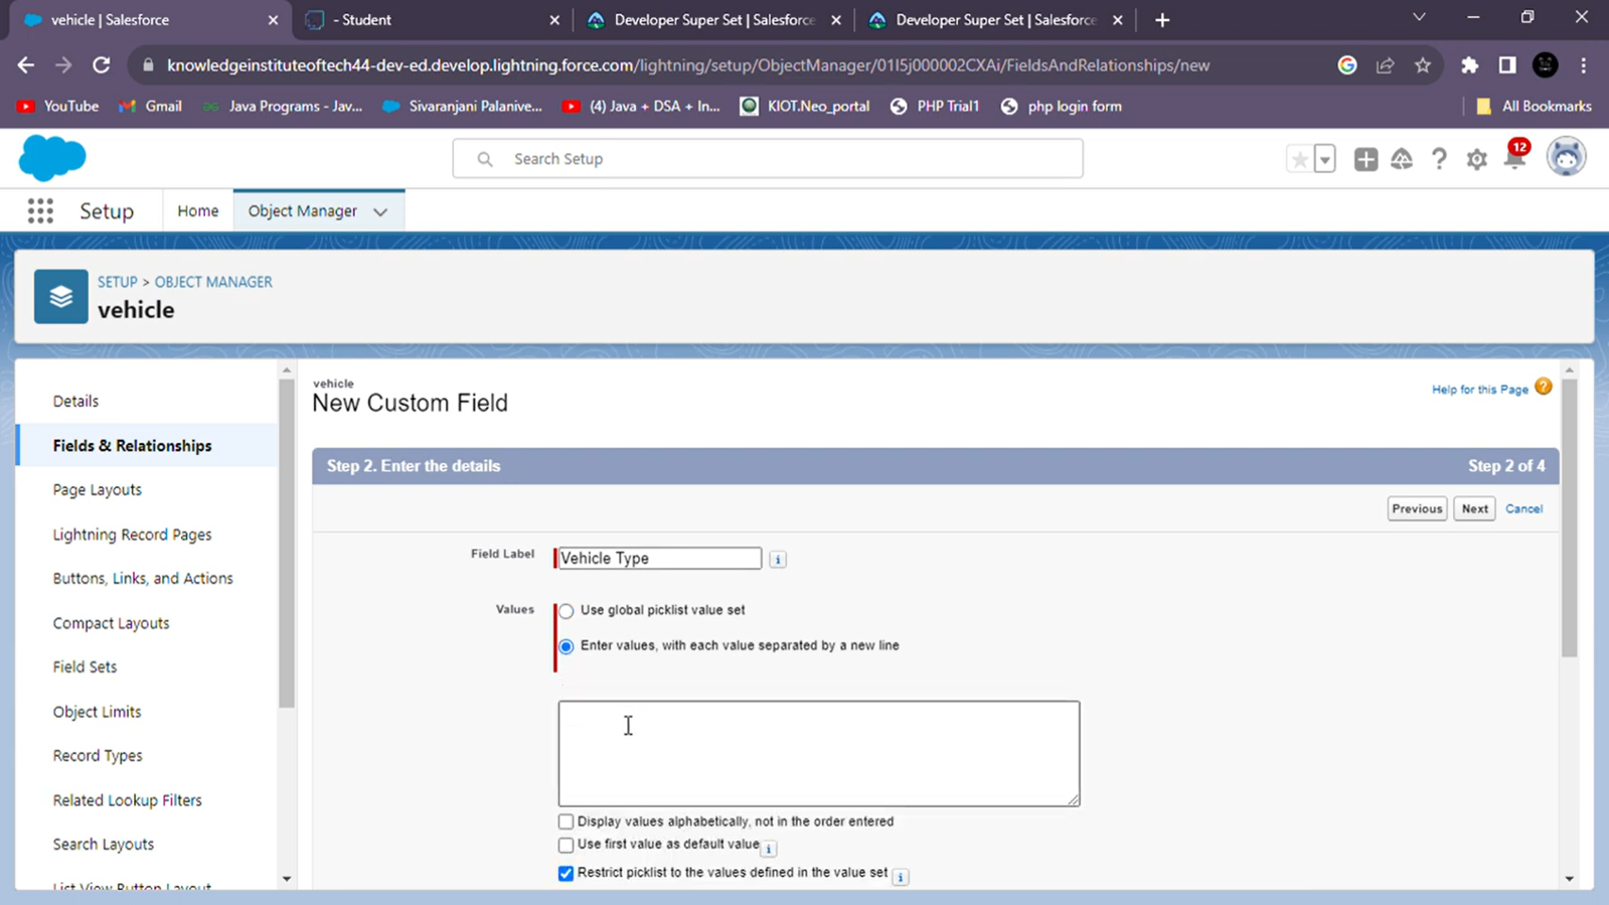
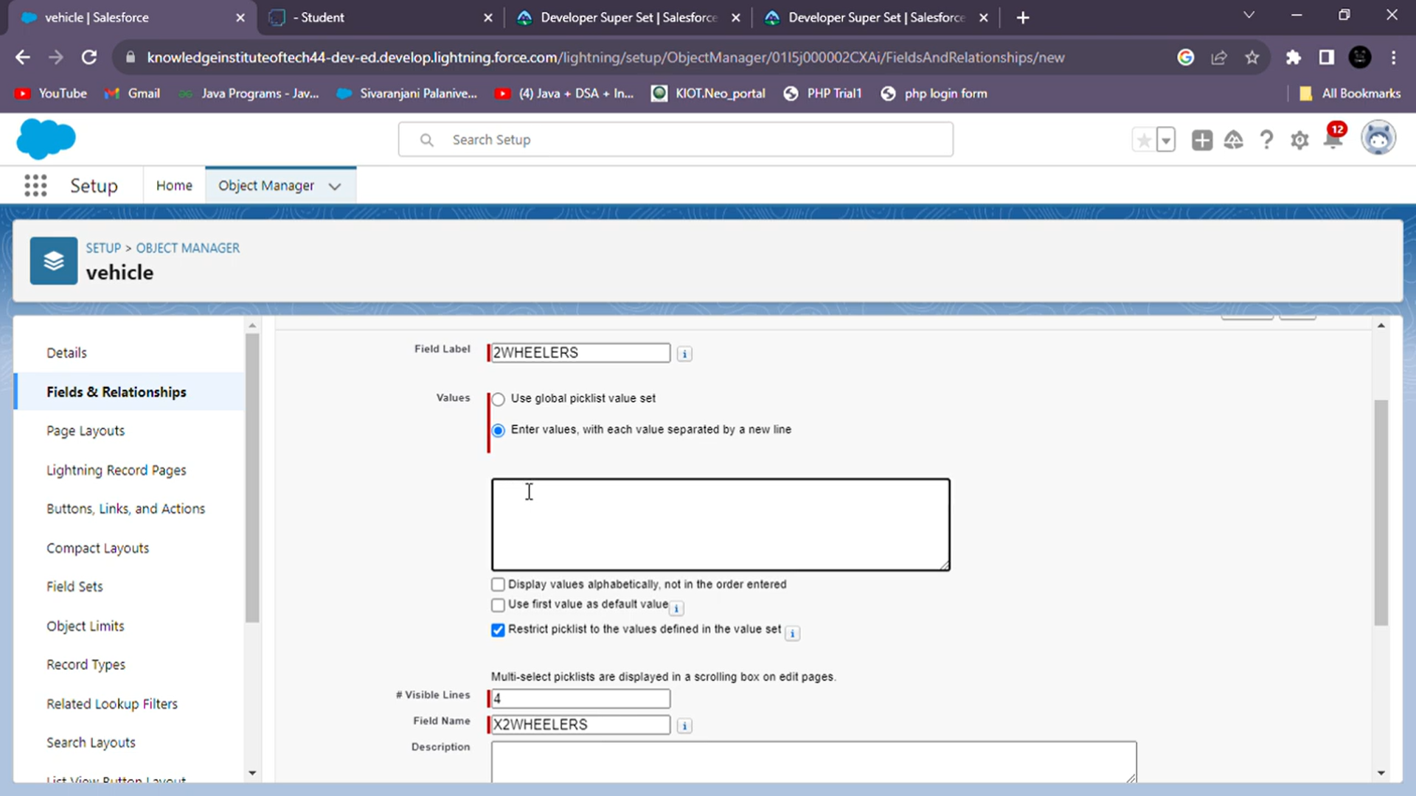

Slide 11
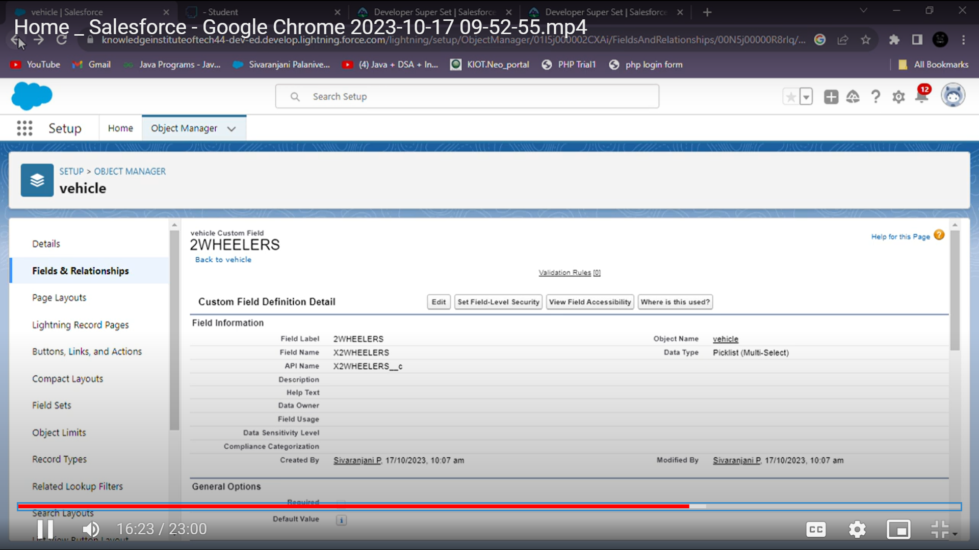
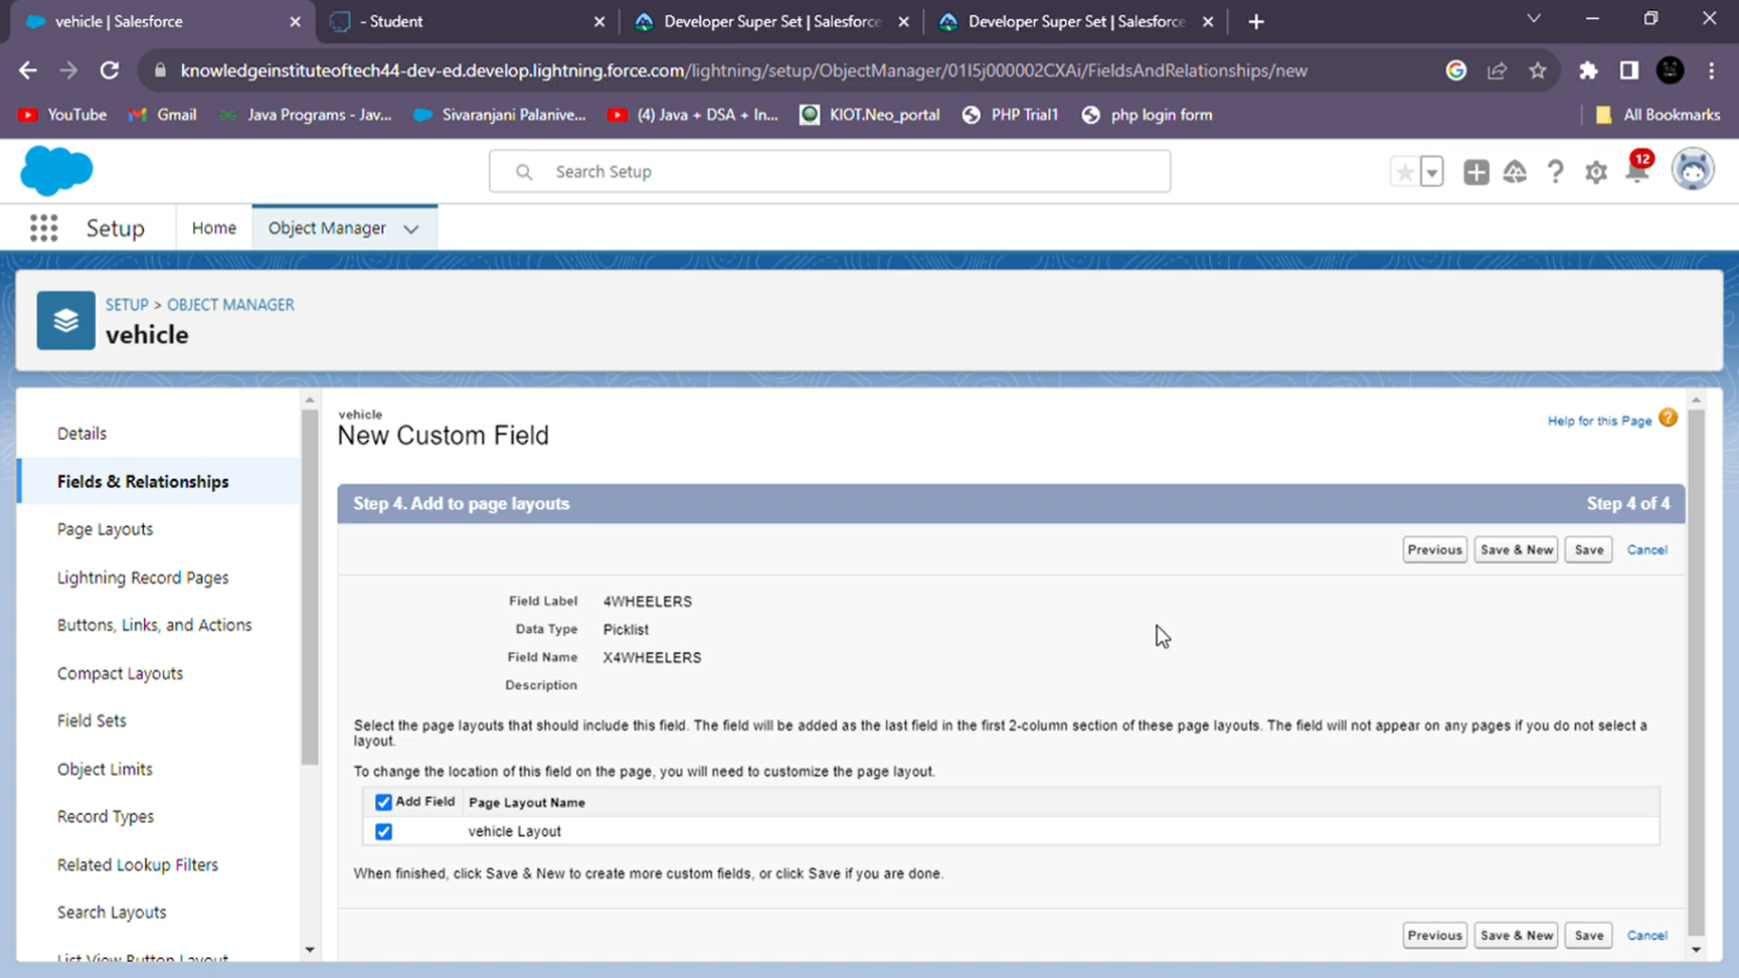

Slide 12
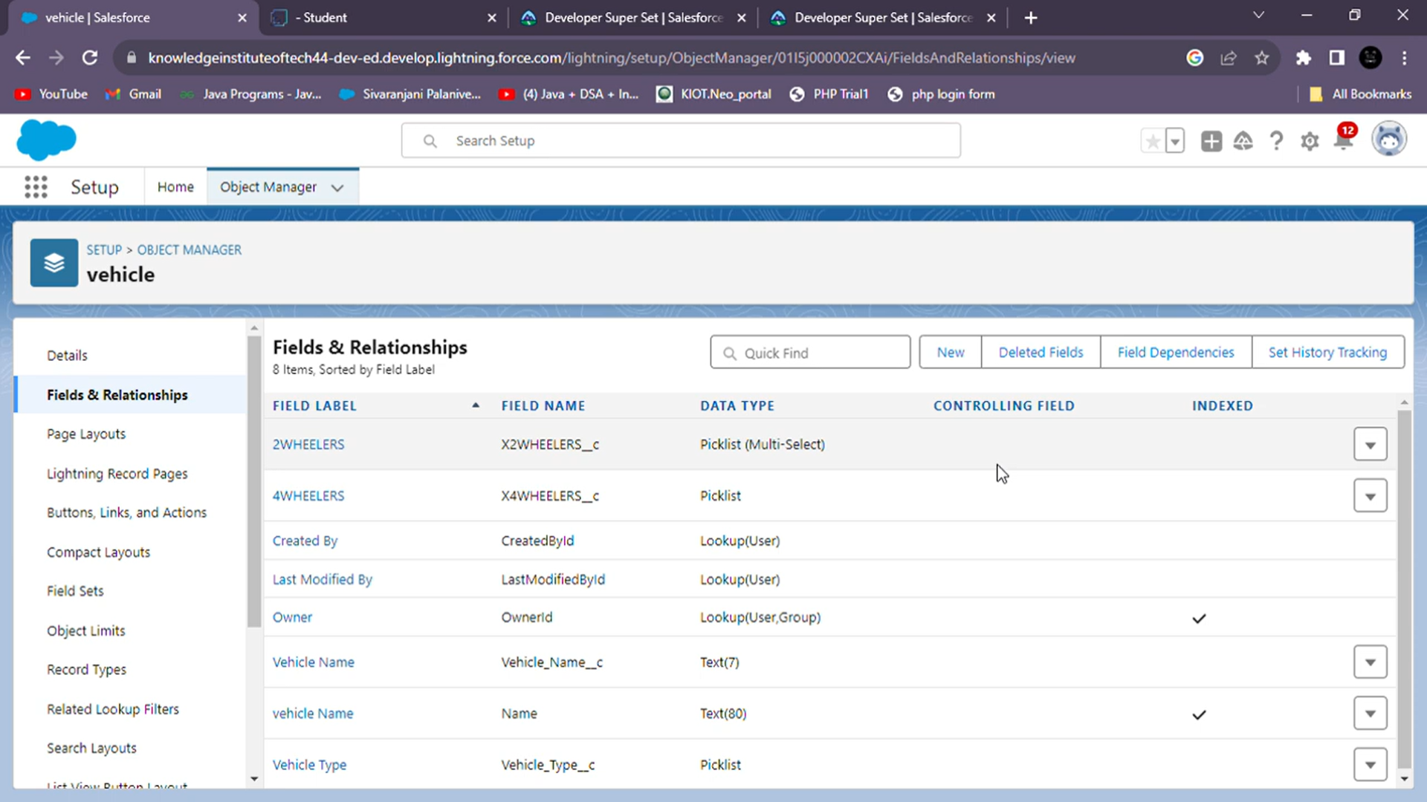

Slide 13
user
In our Vehicle Management System, the "User" experience takes center stage. Tailored interfaces and role-specific functionalities ensure that every team member interacts with the system seamlessly and efficiently.
Key Features for Users:
Intuitive Navigation: An easy-to-use interface enables swift navigation and reduces the learning curve for new users.
Customized Workspaces: Personalized workspaces cater to each user's specific responsibilities, optimizing their workflow.
Real-Time Updates: Users receive timely alerts and updates, keeping them informed and proactive in their tasks.
Automated Task Management: Routine tasks are automated, allowing users to focus on high-impact activities.
Mobile Accessibility: Stay connected and productive on-the-go with mobile-friendly access to critical information.

Slide 14
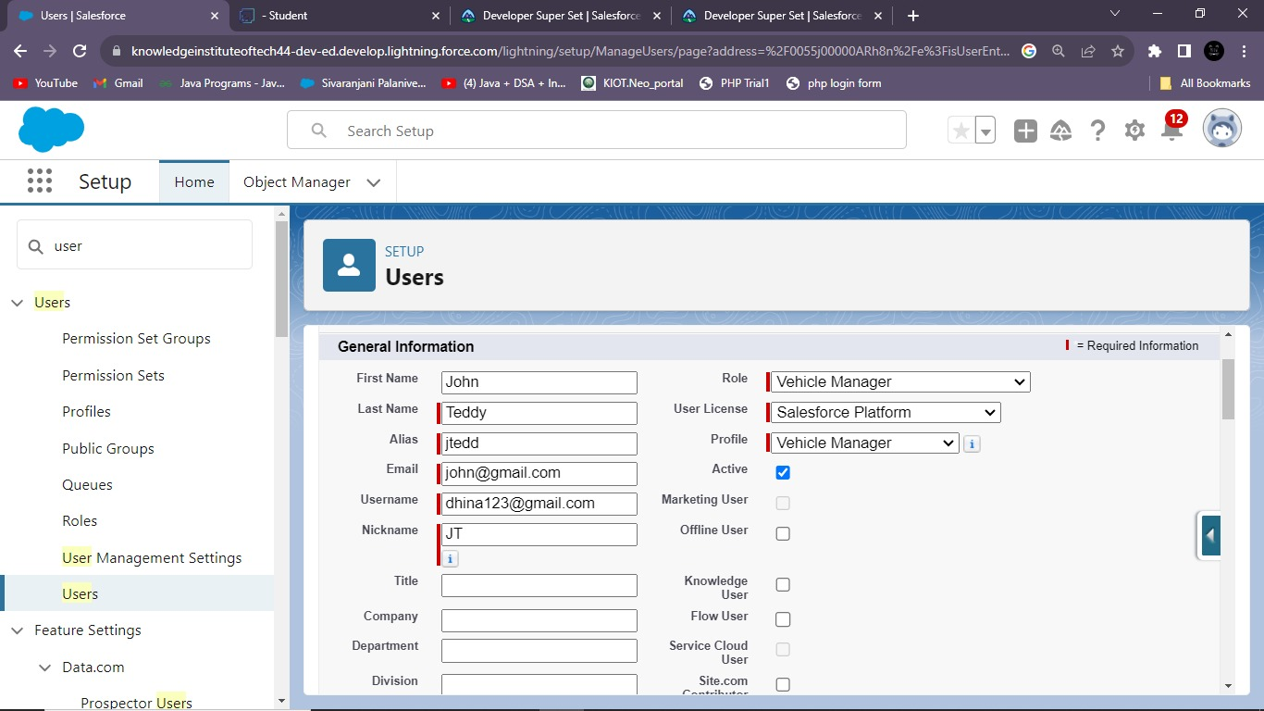
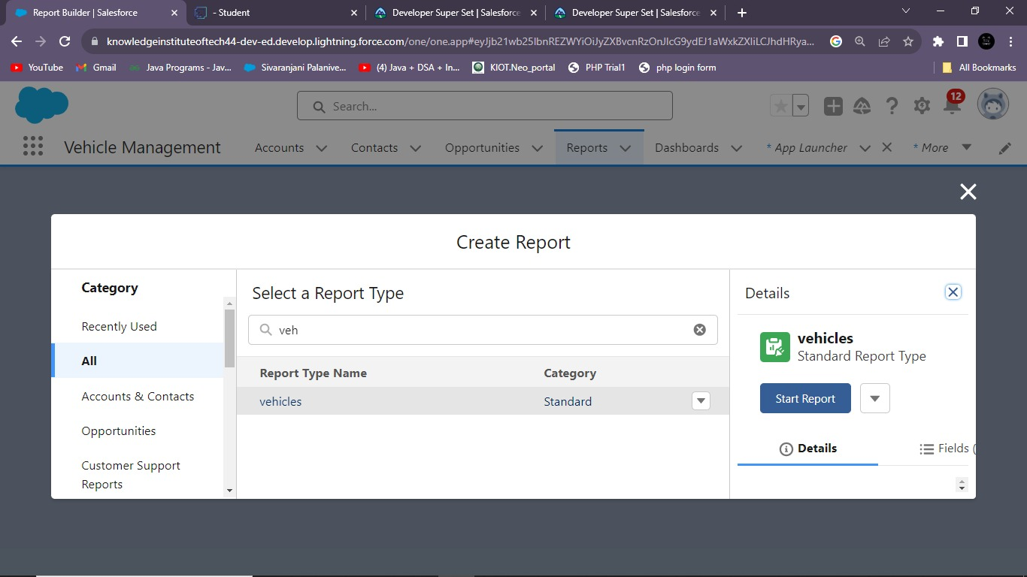

Slide 15
CREATION OF REPORT
The report begins with an overview of the interactive dashboard, providing a real-time snapshot of critical vehicle metrics, including inventory status, maintenance schedules, and performance analytics.
This section focuses on the seamless integration of customer relationship management (CRM) tools within the system, facilitating robust sales processes and enhancing customer interactions.
The report delves into the maintenance module, illustrating how it enables proactive scheduling, tracking, and management of vehicle maintenance tasks, reducing downtime and minimizing operational costs.
A crucial aspect of the report, this section highlights the rich set of analytical tools available, enabling stakeholders to make data-driven decisions and gain deeper insights into vehicle performance, costs, and trends.
This section emphasizes the user-friendly interface and accessibility features, ensuring that all stakeholders can interact with the system intuitively and efficiently.

Slide 16
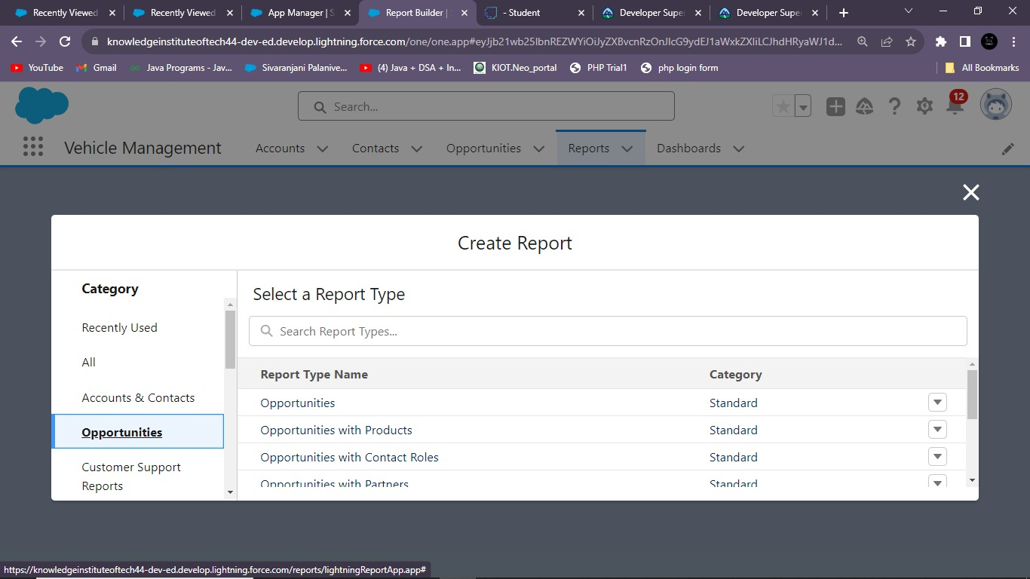
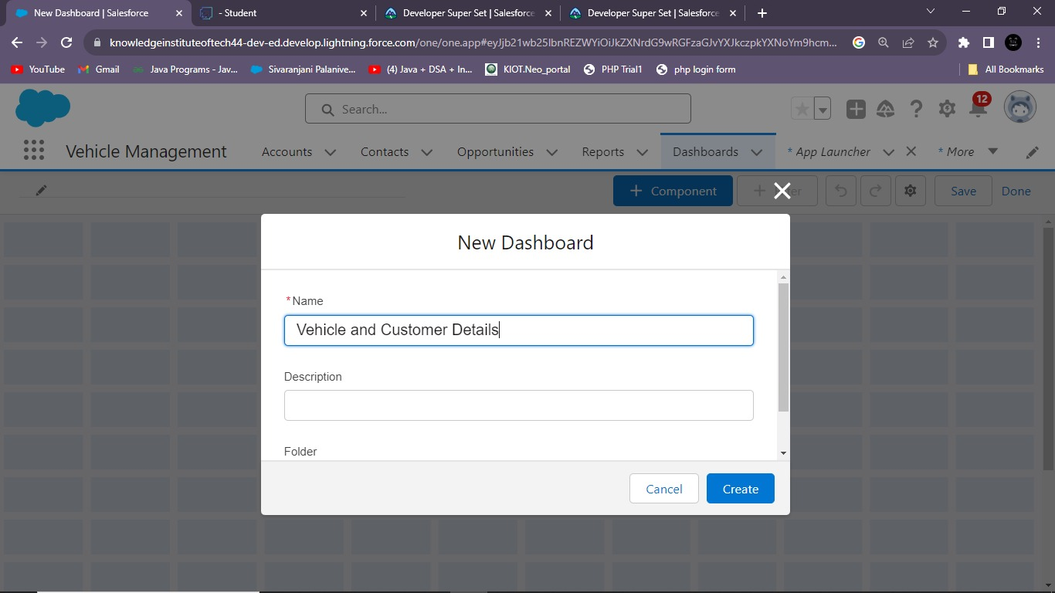

Slide 17
CREATION OF DASHBOARD
The centerpiece of our Vehicle Management System is the dynamic dashboard, providing an instant visual representation of critical vehicle data. It serves as the nerve center for monitoring, analysis, and decision-making.
The dashboard provides an at-a-glance view of current inventory levels, including available vehicles, on-hold units, and those in transit. This real-time insight empowers timely decision-making for procurement and sales teams.
Vital maintenance schedules and upcoming service alerts are prominently displayed, ensuring proactive planning and minimizing unexpected downtimes. Color-coded indicators facilitate quick identification of priority tasks.
The dashboard is equipped with interactive elements, enabling users to drill down into specific data points for more detailed information.

Slide 18
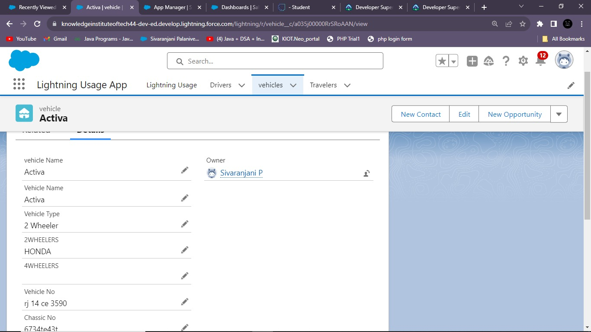
LIGHTNING USAGE APP
The Lightning Usage App is a pivotal component of our Vehicle Management System, designed to enhance user experience and productivity. Tailored for seamless integration with Salesforce Lightning, this app brings a host of powerful features and functionalities to the forefront.

Slide 19
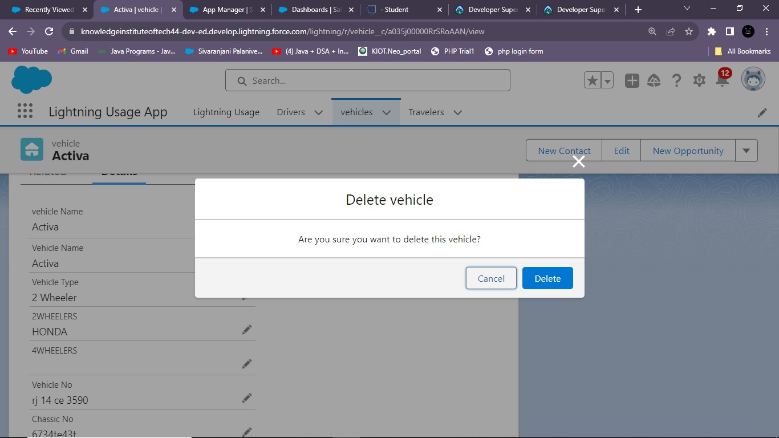

Slide 20
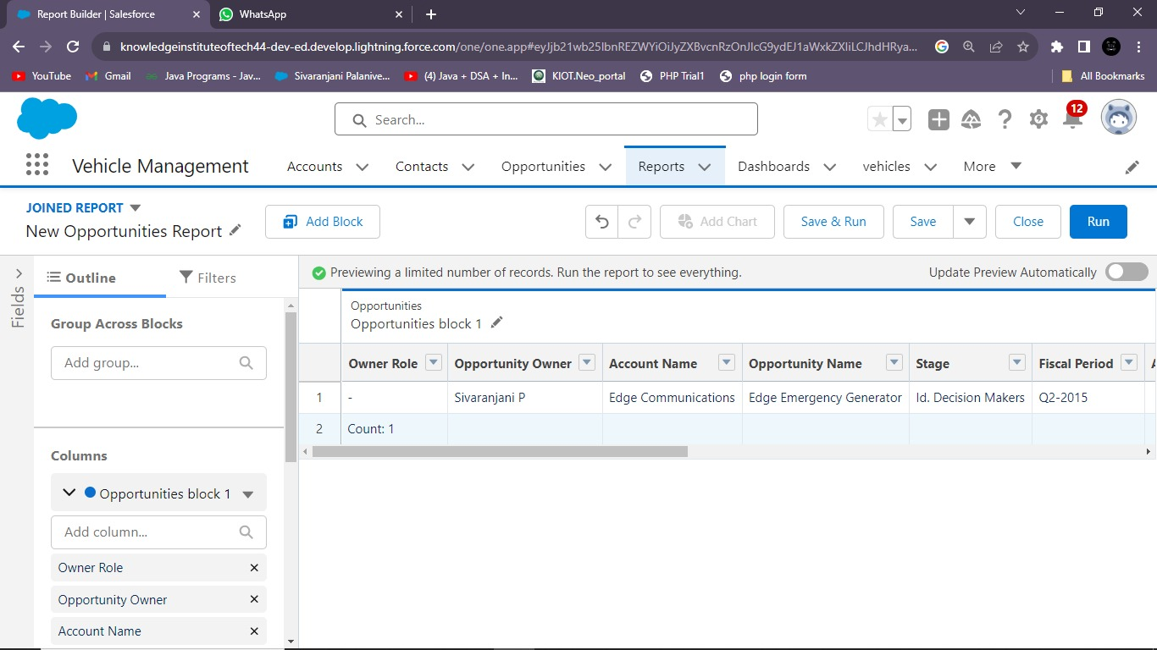
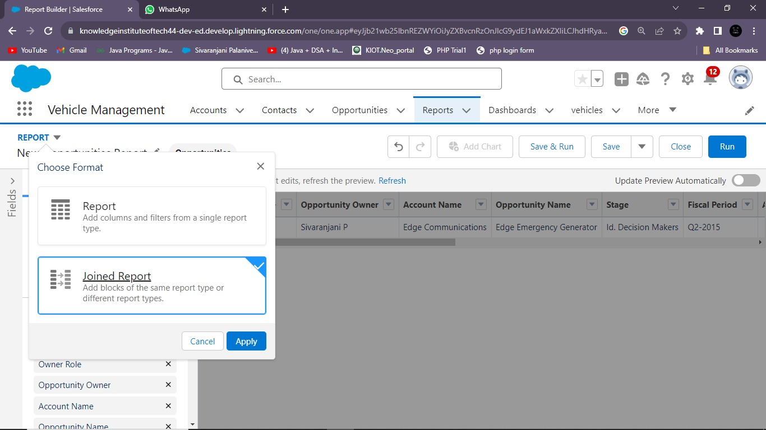

Slide 21
Getting Approval We're thrilled to announce that our Vehicle Management System project has received approval for process automation within Salesforce. This milestone signifies a significant leap forward in streamlining operations and enhancing productivity With process automation, we're poised to: Optimize Workflows: Automate routine tasks and workflows, allowing our team to focus on higher-value activities and strategic initiatives. Increase Responsiveness: Prompt notifications and automated responses ensure timely actions, providing superior service to our clients and partners. Enhance Data Accuracy: Automation minimizes manual data entry, reducing the risk of errors and ensuring the integrity of our records.

Slide 22
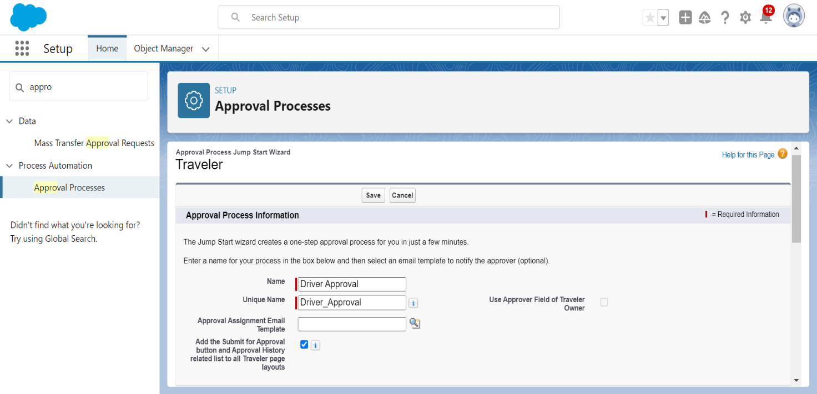

Slide 23
GitHub Link :
https://github.com/jo-canva/naanmudhalvan-2
Project Video Demo Link : https://drive.google.com/file/d/1ouUiqHCLZacEYYBcJbQj7tnohF1yKa-z/view?usp=sharing

Slide 24
Thank you

